Slide 1

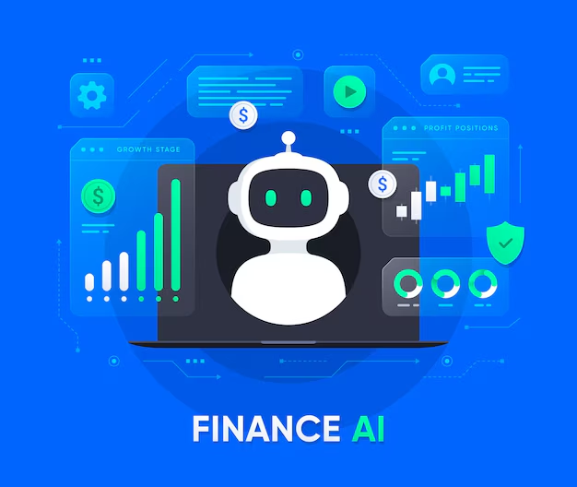

PROJECT TITLE
QnA Bot – AI in Finance
Presented by:
Rupak Charan V

Slide 2
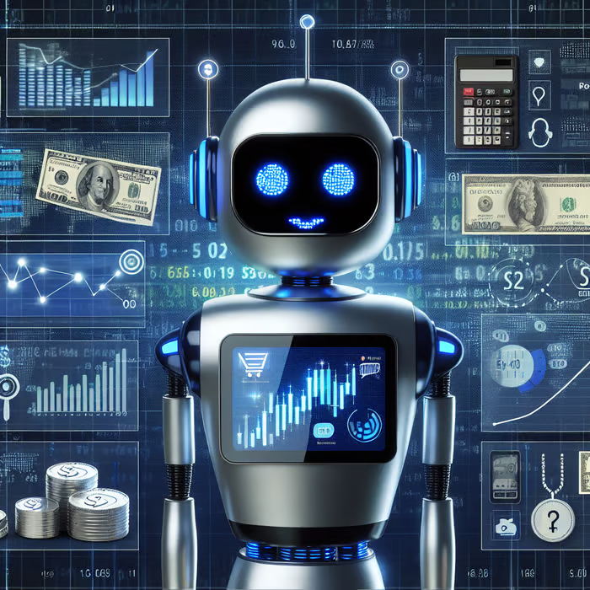
I. Project Overview
AI-driven QnA bot focused on finance domain
Uses NLP to answer finance-related queries
Accessible to professionals and general users

Slide 3


II. Problem Statement
Finance is complex and filled with jargon
Searching for information is time-consuming
Need for conversational AI with contextual knowledge

Slide 4
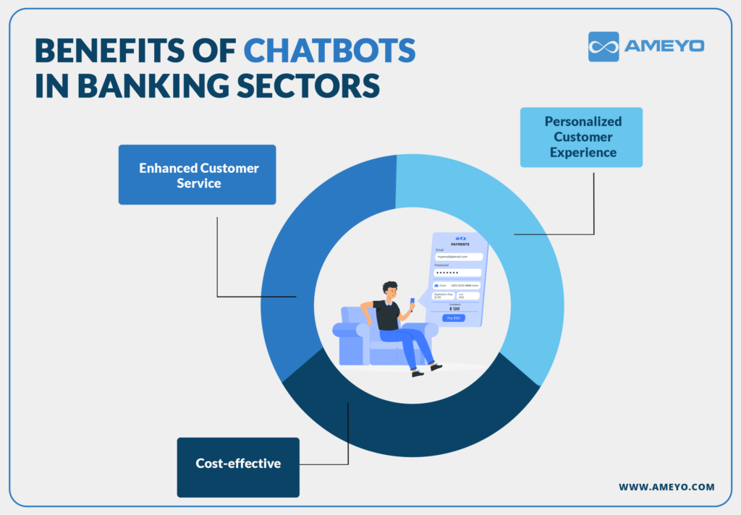

III. Objectives
Study existing QnA systems in finance
Analyze suitable datasets and models
Design initial architecture for implementation

Slide 5

IV. Research Work
Studied QnA systems: BERT, T5, RoBERTa, FinBERT
Datasets: FinQA, FiQA, Financial PhraseBank
Context sources: Wikipedia, Investopedia

Slide 6

V. Tools & Technologies
Python, Transformers (HuggingFace), FinBERT
Streamlit/Flask for UI
Pandas, NumPy, NLTK, Scikit-learn

Slide 7

VI. Proposed Methodology
Data preprocessing and tokenization
Model fine-tuning (BERT/FinBERT)
Context retrieval and answer extraction
Basic Streamlit interface

Slide 8
VII. Use Cases
Financial education tool
Quick access for professionals
FAQ automation in banking

Slide 9
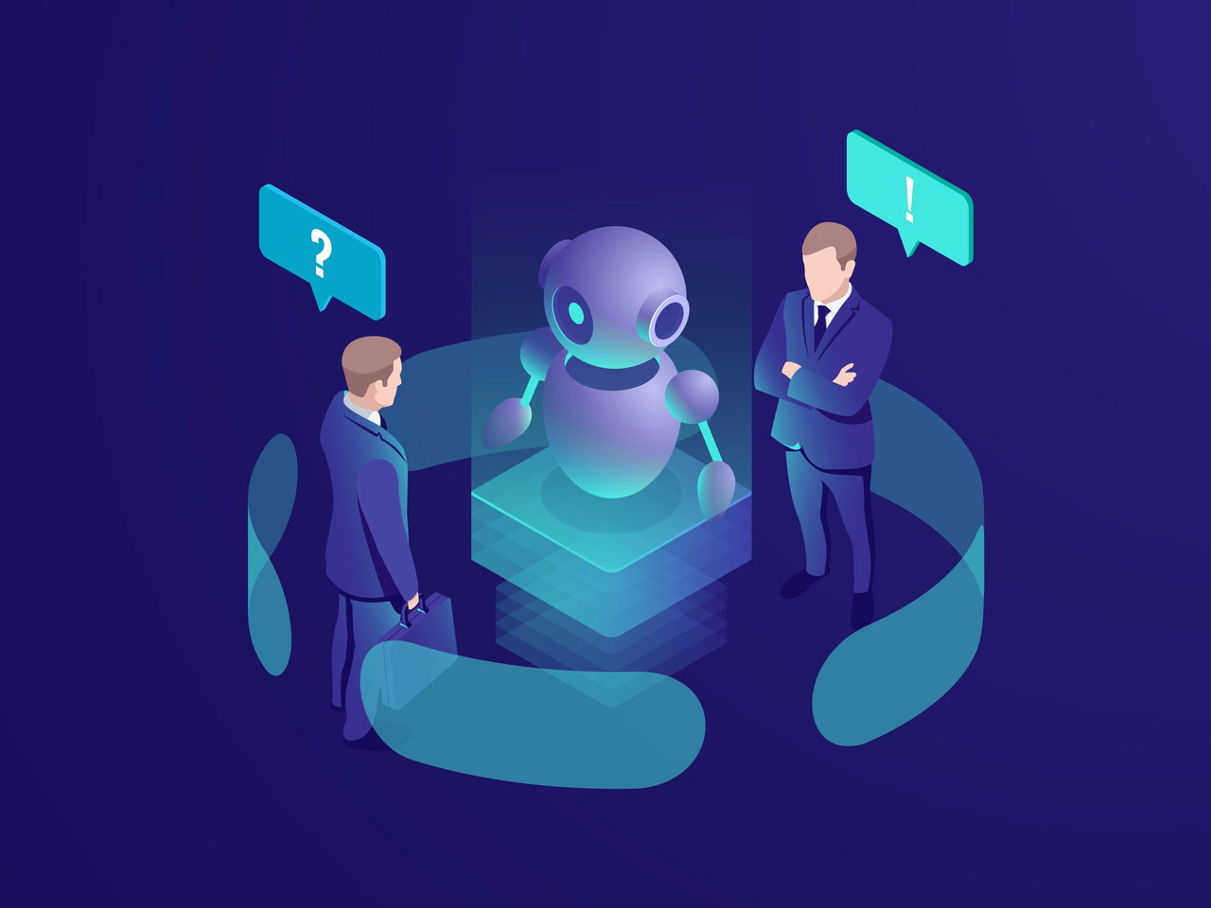
VIII. Challenges & Risks
Limited labeled datasets
Domain-specific complexity
Ambiguity in user queries

Slide 10

Thank You

